Slide 1
Chapter 2b:
Single-Area OSPFv2
Notes:
Cisco Networking Academy program
Routing Protocols
Chapter 8

Slide 2
Chapter 2b
8.1 Characteristics of OSPF
8.2 Configuring Single-area OSPFv2
Notes:
Chapter 8

Slide 3
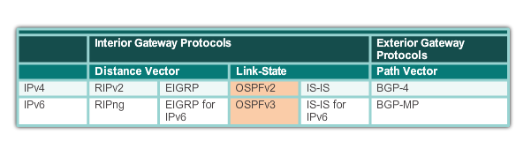
Open Shortest Path First
Evolution of OSPF
Interior Gateway Protocols
Invented in 1991, OSPFv2 supports IPv4
In 1999, OSPFv3 was created to support IPv6
OSPF Is a Link-State routing protocol
Administrative Distance (AD) is 110
Metric is known as “Cost”
Notes:
8.1.1.1 Evolution of OSPF

Slide 4
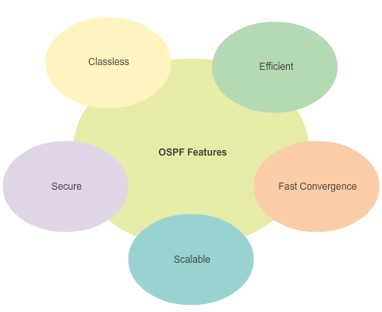
Open Shortest Path First
Features of OSPF
Classless - supports VLSM and CIDR
Efficient - triggered updates (not periodic updates). It uses the Shortest Path First (SPF) algorithm to choose best paths
Fast convergence - network changes are propagated quickly
Scalable - works well in small or large networks. For large networks, routers can be grouped into areas to support a hierarchical system (multi-area OSPF)
Secure - supports Message Digest 5 (MD5) authentication which accepts routing updates from peer routers with the same pre-shared password.
Notes:
8.1.1.2 Features of OSPF

Slide 5
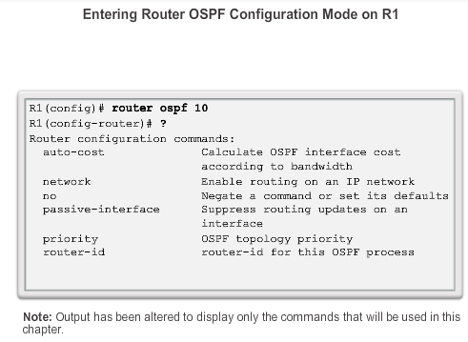
OSPF Router ID
OSPF Network Topology
# router ospf [ process-id ]
Using process-id 10 in this example
Note that process-id is of local significance only. It doesn’t have to be the same across all routers.
Notes:
8.2.1.2 Router OSPF Configuration Mode

Slide 6
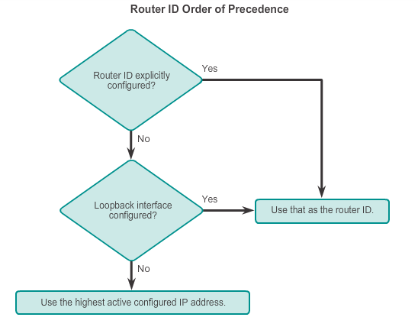
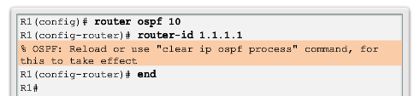
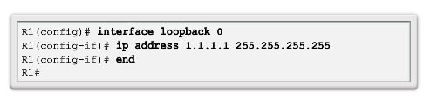
OSPF Router ID
Router IDs
Every router in an OSPF domain requires a router ID to:
Uniquely identify the router
Participate in the election of the DR in a multi-access LAN environment
Order of precedence:-
router-id command
Highest loopback interface
Highest active interface IP address
Notes:
8.2.1.3 Router IDs
8.2.1.4 Configuring an OSPF Router ID
8.2.1.5 Modifying a Router ID
8.2.1.6 Using a Loopback Interface as the Router ID

Slide 7
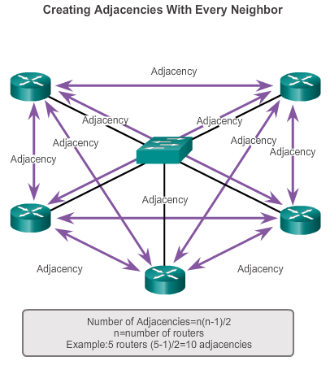
OSPF Operation
OSPF DR and BDR
Question:
Why is a DR and BDR election necessary?
Creation of multiple adjacencies is unnecessary and undesirable as it leads to excessive exchange of LSAs.
Excessive flooding of LSAs each time there is a change in network topology.
Solution:
Elect a DR and BDR to manage the collection and distribution of LSAs.
Notes:
8.1.3.3 OSPF DR and BDR

Slide 8
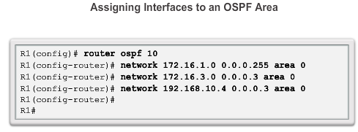
Configure Single-area OSPFv2
The network Command
First, identify the router’s directly connected networks.
In the router configuration mode, advertise the network address of the directly connected networks using the “network” command together with the OSPF area number
Notes:
8.2.2.1 Enabling OSPF on Interfaces
8.2.2.2 Wildcard Mask
8.2.2.3 The network Command

Slide 9
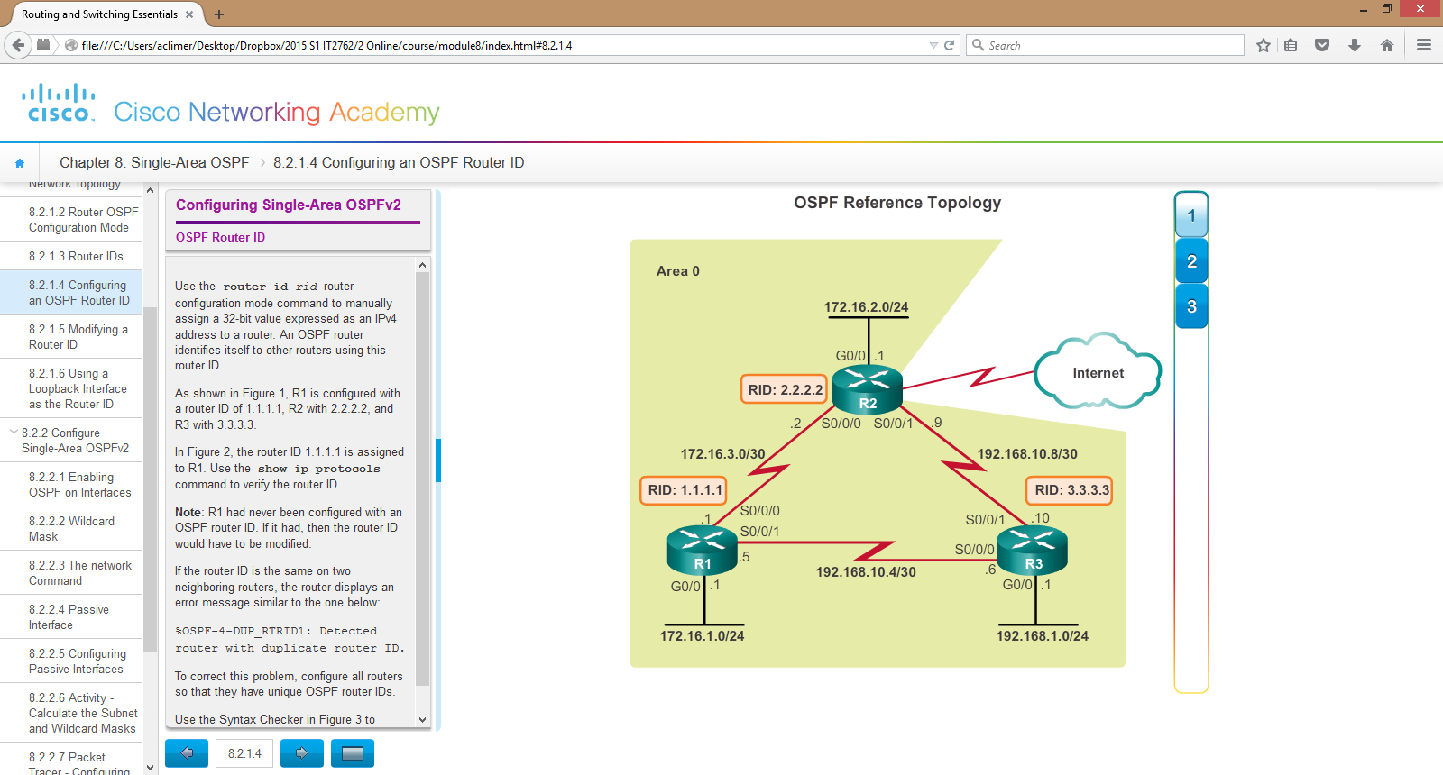
Configure Single-Area OSPFv2
Passive Interface
By default, OSPF LSAs are forwarded out all OSPF-enabled interfaces, but these LSAs are useful only to other OSPF-enabled routers.
Sending out unneeded messages on a LAN (switch and PCs) affects the network in three ways:
  Inefficient Use of Bandwidth
  Inefficient Use of Resources
  Increased Security Risk
Use the Passive Interface feature to limit the scope of routing updates advertisements.
Using the example here, from the router config mode, run the command:-
# router ospf 10
# passive-interface g0/0
To LAN
Notes:
8.2.2.4 Passive Interface

Slide 10
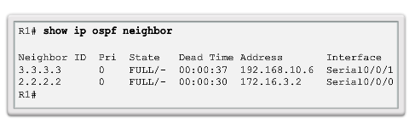
Verify OSPF
Verify OSPF Operation
Verify OSPF operation using these commands:-
OSPF neighbours
OSPF protocol configured
Running configuration
Routing table
OSPF interfaces configured
1. OSPF neighbors: #show ip ospf neighbors
Verify that the router has formed an adjacency with its neighboring routers.
Notes:
8.2.4.1 Verify OSPF Neighbors

Slide 11
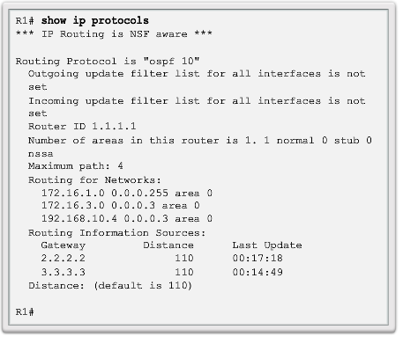
Verify OSPF
Verify OSPF Operation (cont’d)
2. OSPF protocol configured #show ip protocols
Process ID
Router ID
Networks advertised
Neighbour routers
AD
Notes:
8.2.4.2 Verify OSPF Protocol Settings

Slide 12
Verify OSPF
Verify OSPF Operation (cont’d)
3. Running config file #show run
Check that the configuration is correct.
# show run
<-- output omitted -->
!
router ospf 1
router-id 1.1.1.1
log-adjacency-changes
passive-interface GigabitEthernet0/0
network 172.16.1.0 0.0.0.255 area 0
network 172.16.3.0 0.0.0.3 area 0
network 192.168.10.4 0.0.0.3 area 0
!
Notes:
8.2.4.2 Verify OSPF Protocol Settings

Slide 13
Verify OSPF
Verify OSPF Operation (cont’d)
4. Routing Table #show ip route ospf
Check that the number of remote routes learned is correct.
R1#
R1#show ip route ospf
172.16.0.0/16 is variably subnetted, 5 subnets, 3 masks
O 172.16.2.0/24 [110/65] via 172.16.3.2, 00:06:22, Serial0/0/0
O 192.168.1.0/24 [110/65] via 192.168.10.6, 00:03:08, Serial0/0/1
192.168.10.0/24 is variably subnetted, 3 subnets, 2 masks
O 192.168.10.8/30 [110/128] via 172.16.3.2, 00:03:08, Serial0/0/0
[110/128] via 192.168.10.6, 00:03:08, Serial0/0/1
R1#
Notes:
8.2.4.2 Verify OSPF Protocol Settings

Slide 14
Verify OSPF
Verify OSPF Operation (cont’d)
5. OSPF interfaces configured #show ip ospf interface { int-ID }
More info about the OSPF interfaces like cost, IP address, timers etc.
R1#show ip ospf interface g0/0
GigabitEthernet0/0 is up, line protocol is up
Internet address is 172.16.1.1/24, Area 0
Process ID 1, Router ID 1.1.1.1, Network Type BROADCAST, Cost: 1
Transmit Delay is 1 sec, State WAITING, Priority 1
No designated router on this network
No backup designated router on this network
Timer intervals configured, Hello 10, Dead 40, Wait 40, Retransmit 5
No Hellos (Passive interface)
Index 1/1, flood queue length 0
Next 0x0(0)/0x0(0)
Last flood scan length is 1, maximum is 1
Last flood scan time is 0 msec, maximum is 0 msec
Neighbor Count is 0, Adjacent neighbor count is 0
Suppress hello for 0 neighbor(s)
Serial0/0/0 is up, line protocol is up
Internet address is 172.16.3.1/30, Area 0
Process ID 1, Router ID 1.1.1.1, Network Type POINT-TO-POINT, Cost: 64
Transmit Delay is 1 sec, State POINT-TO-POINT, Priority 0
Notes:
8.2.4.2 Verify OSPF Protocol Settings

Slide 15
OSPF Router ID
OSPF Network Topology
Lets use this network topology as example:-
Notes:
8.2.1.2 Router OSPF Configuration Mode

